Slide 1
Blood smear

Slide 2
Blood smear
blood smear is one of the most frequently requested tests in the hematology laboratory.
Blood smear must be prepared correctly and examined in such a way as to provide the physician with an accurate interpretation.

Slide 3
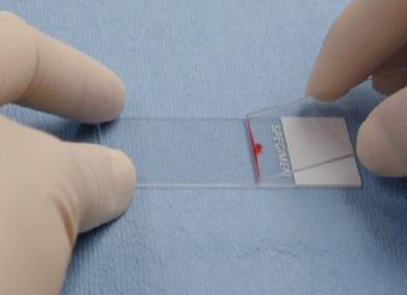
Procedure
Place a drop of blood from the finger
about 2 mm in diameter in the central line
of a slide about 1-2 cm from one end.
2.The spreader is placed at angle of 45
degrees to the slide and then moved
back to make contact with the drop.

Slide 4
The drop should spread out quickly along the line of contact of the spreader with the slide.
The drop should be of such size that the film is 3-4 cm in length.

Slide 5
The film should be dried rapidly. A good blood film preparation will be thick at the drop end and thin film at the opposite end.
The thickness of the spread when pulling the smear is determined by the:
Angle of the spreader slide.
Size of the blood drop.
Speed of spreading.

Slide 6
Fixing of blood films
Before staining, the blood films need to be fixed with methyl alcohol for 0.5 to 2 minutes in order to prevent hemolysis when they come in contact with water when water has to be added subsequently. Alcohol denature the proteins and hardness the cell contents.

Slide 7
Stain preparation and staining
Leishmans stain
Composition
Powdered Leishmans stain 0.15 mg
Methyl alcohol 133 ml
Method of staining
Pour few drops (about 8) on the slide, Wait for two minutes.
Add double the amount (16 drops) of buffered water. Mix by rocking and wait for 7-10 minutes.
The stain is flooded off with distilled water and this should be complete in 2-3 second, and allow it to dry.

Slide 8
Giemsa stain
Giemsa powder 0.3 mg
Glycerin 25 ml
Methyl alcohol 25ml
This makes stock solution and before use it has to be diluted by adding 1 ml (stain) to 9 ml buffered water.
Method of staining
The blood is fixed with methyl alcohol for 2 minutes.
Pour Giemsa stain diluted 1:9 with buffer over the smear for 8-10 minutes.
Wash off with buffer and dry.

Slide 9
Examination of a blood film
There are several necessary step in the examination of a peripheral blood smear:
Under the low- power (10X), determine the overall staining quality of the blood smear.
Determine if there is a good distribution of cells on the smear.
Find an optimal area for the detailed examination and enumeration of cells.
The dry and stained film is examined without a coverslip under oil immersion objective.

Slide 10
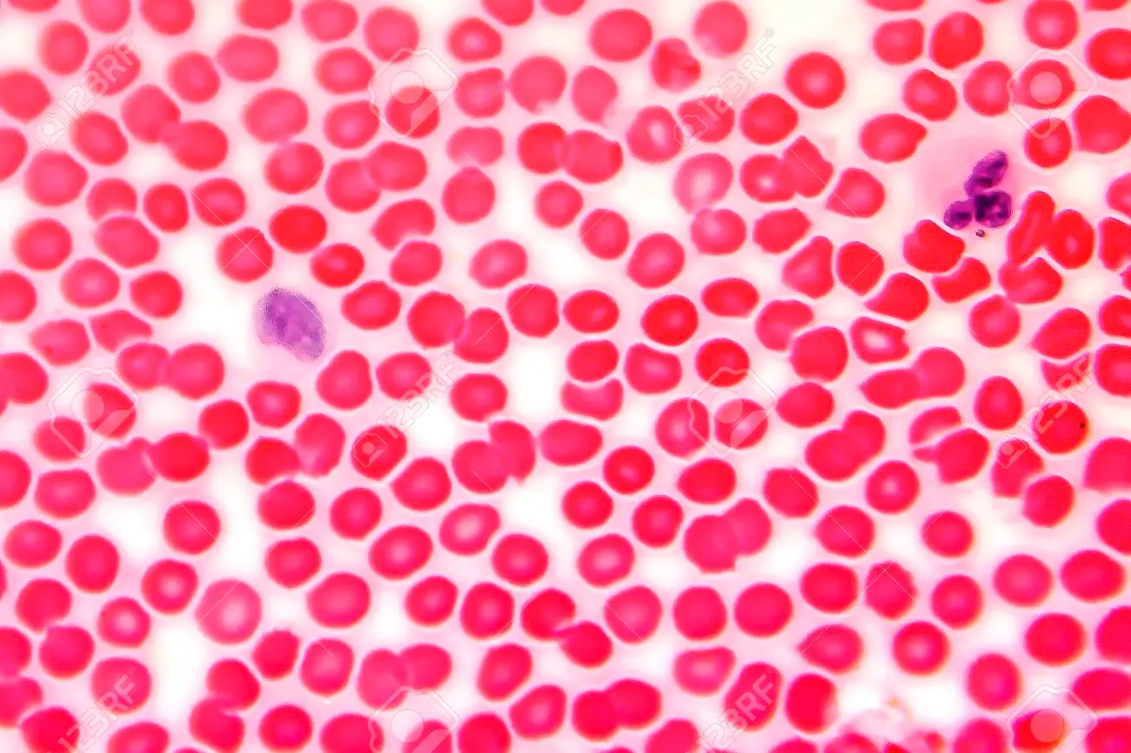

Slide 11
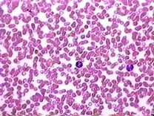
Blood Smear at 400x

